Slide 1
Data-422-20S2 Data WRANGLING
Lecturer: Giulio Dalla Riva, Thomas Li
University of Canterbury
Prepared By
Prasoon Sharma (57073928)
Sharmistha Dutta (29625569)
Sanjay Girish Chauhan (78021823)
Mahesh Pandey (98081390)
Anoop Murugan Krishnan (43544346)
14th Oct 2020
Data Wranglers

Slide 2
Objectives
To collect data from the reliable sources.
Cleaning and preprocessing.
Data analysis on movie data from IMDB and Rotten Tomatoes.
Data Wranglers

Slide 3
Research Questions
Research Questions
Data Wranglers
Data Wranglers
3

Slide 4
Research Questions
What is the relation between ratings, years and number of users involved for movie review.
Summary of movie genre year wise.
Data analysis on movies from 2015-2020.
Data Wranglers

Slide 5
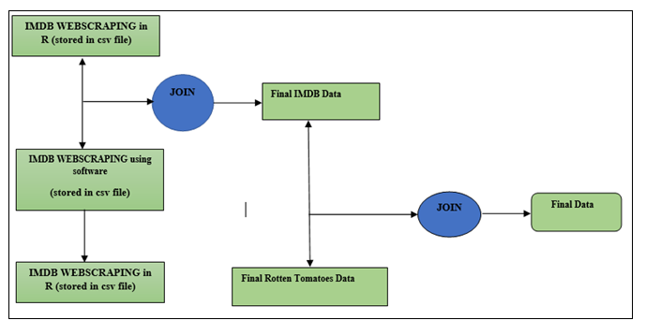
Data Sources & Data Preparation
Data Wranglers

Slide 6




Approach & Methodology
Data Wranglers

Slide 7
Methodology
Cleaning of structuring of data
Removal of unnecessary information
Handing of missing values
Data Wranglers

Slide 8
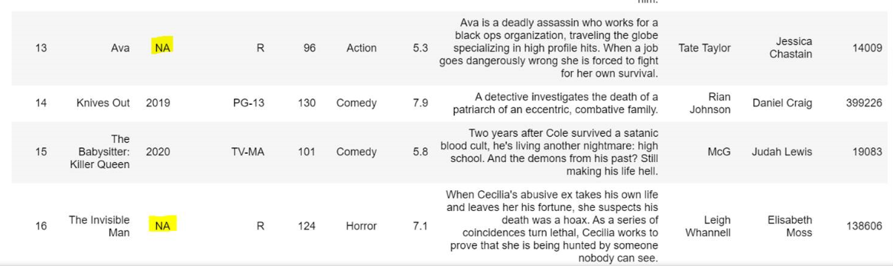
Examples
Row count before cleaning -
Row count before cleaning -
Data Wranglers

Slide 9
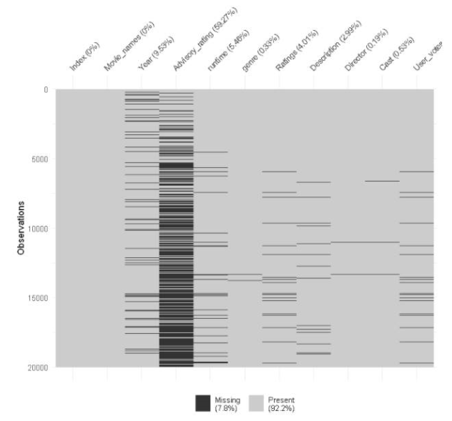
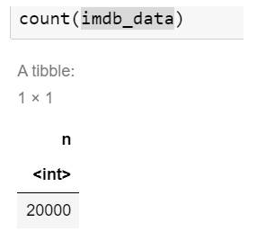
Examples
Visualization of missing data
Row count of missing data
Data Wranglers

Slide 10
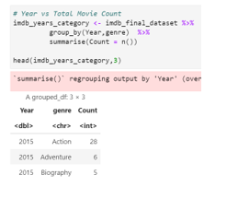
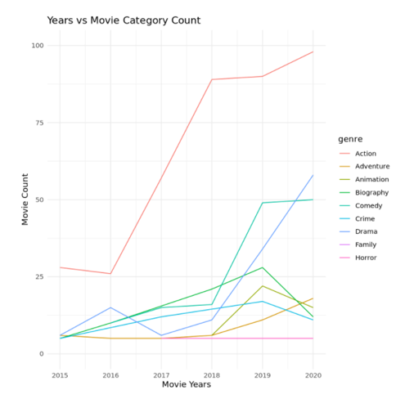
Visualizations
Data Wranglers

Slide 11
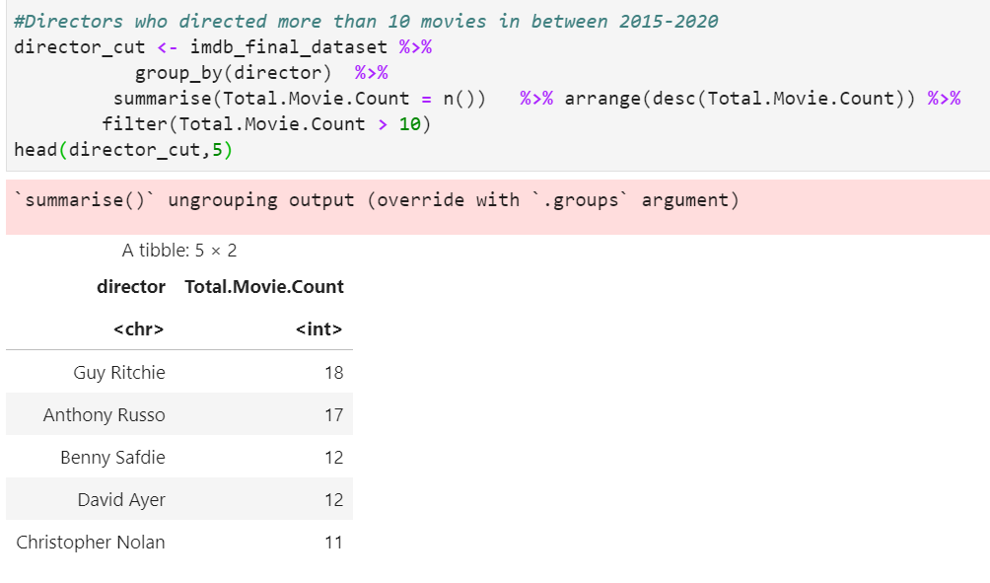
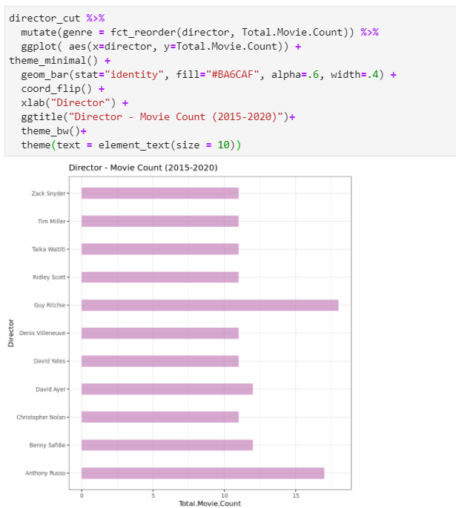
Visualizations Cont..
Data Wranglers

Slide 12
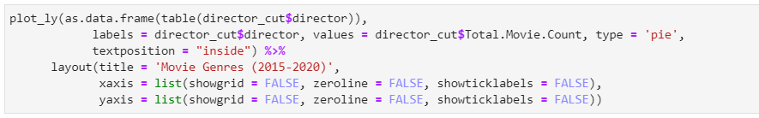
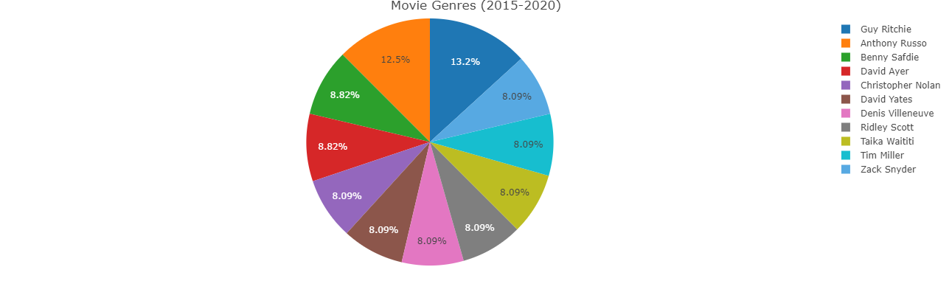
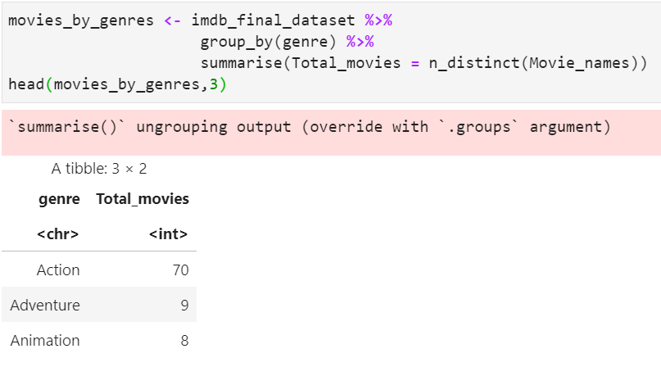
Visualizations Cont..
Data Wranglers

Slide 13
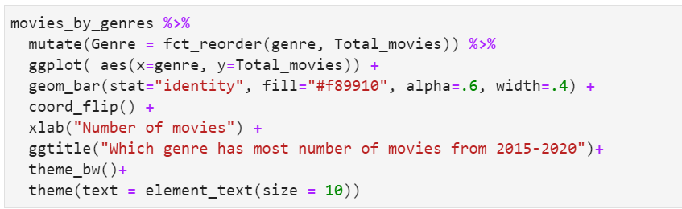
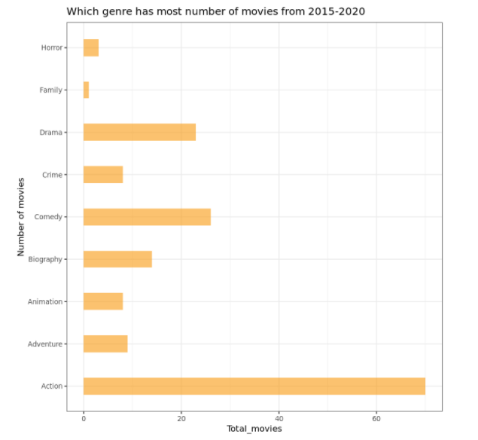
Visualizations Cont..
Data Wranglers

Slide 14
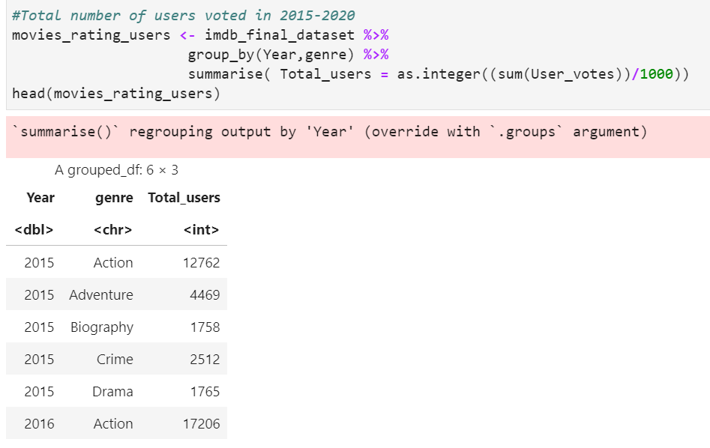
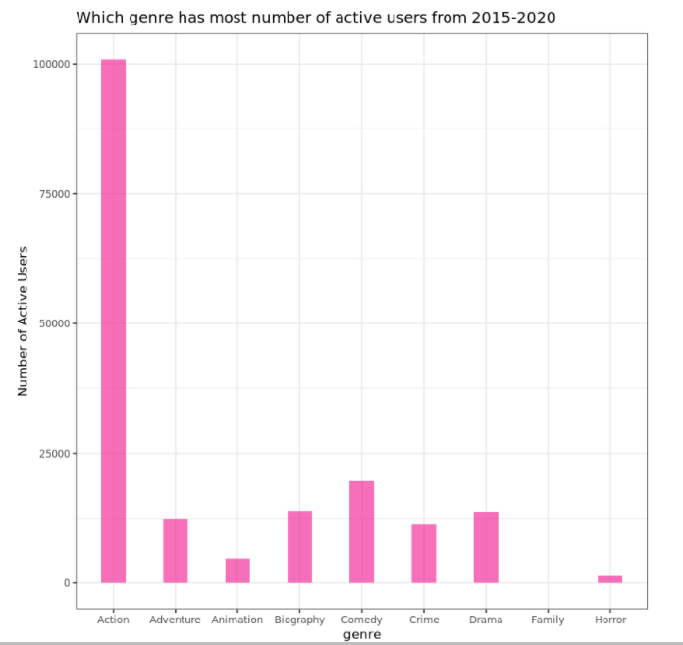
Visualizations Cont..
Data Wranglers

Slide 15
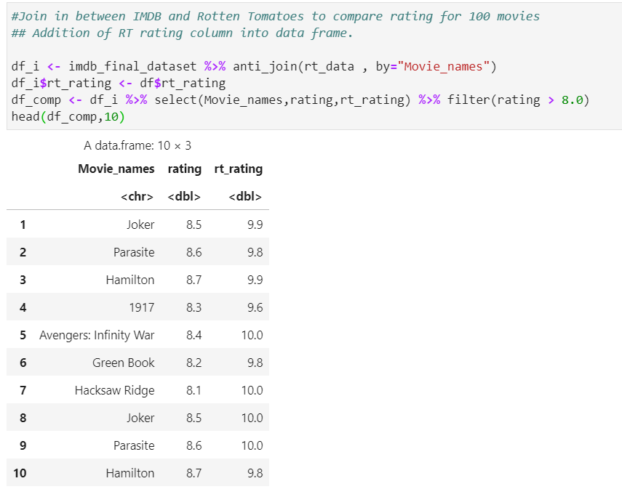
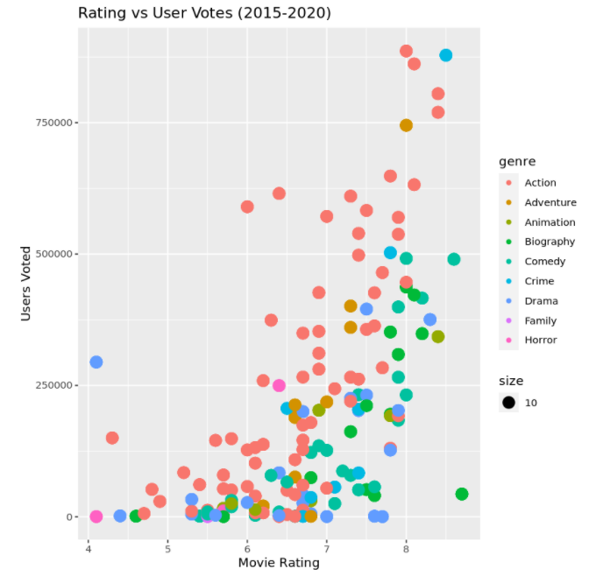
Visualizations Cont..
Data Wranglers

Slide 16

Challenges
Data Wranglers

Slide 17
challenges
To collect data from the reliable sources.
Cleaning and preprocessing.
Data analysis on movie data from IMDB and Rotten Tomatoes.
Data Wranglers

